Slide 1
Lecture – 15

Slide 2
The ALU Control
The main control unit reads instruction opcode and generates the necessary control signal.
ALU Control is a small control unit separate from the main control unit.
It takes 2-bit control signal ALUOp from the main control unit and the instruction function field [5:0] and generates the necessary control signal for the ALU.
Multi-level Decoding:
It reduces the size of main control unit.
Increases the speed of control unit.

Slide 3
The ALU Control
ALU has four control inputs. Only 6 of the 16 possible input combinations are used in this subset.
ALU control lines | Function
0000 | AND
0001 | OR
0010 | Add
0110 | Subtract
0111 | set on less than
1100 | NOR
For load word and store word instructions, we use the ALU to compute the memory address by addition.
For the R-type instructions, the ALU needs to perform one of the five actions (AND, OR, subtract, add, or set on less than) depending on the value of the 6-bit funct field.
For branch equal, the ALU perform a subtraction.

Slide 4
The ALU Control
A 2-bit control field called ALUOp indicates what type operation is carried out.
ALUOp is (00) to perform add for load and store instruction.
ALUOp is (01) to perform subtract for beq.
ALUOp is (10) for arithmetic-logical instruction.

Slide 5
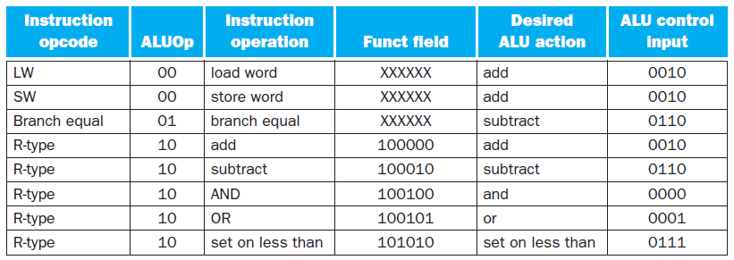
The Truth Table

Slide 6
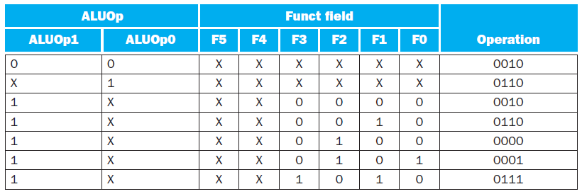
The Truth Table

Slide 7
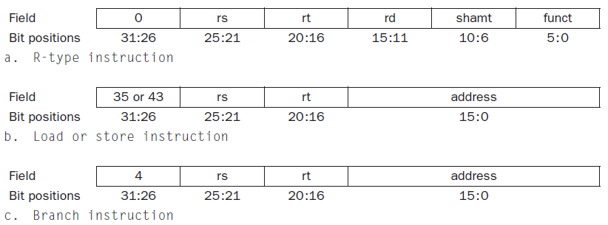
Instruction Format

Slide 8
Several Major Observations
The opcode is always contained in bits 31:26.
Two registers to be read always specified by the rs[25:21] and rt [20:16]. This is true for R-type, branch equal and store instruction.
The base register for load and store instruction is always in rs[25:21].
The 16-bits offset for branch equal, load and store is always in position 15:0.
The destination register for load is rt[20:16] and for R-type instruction it is rd[15:11].

Slide 9
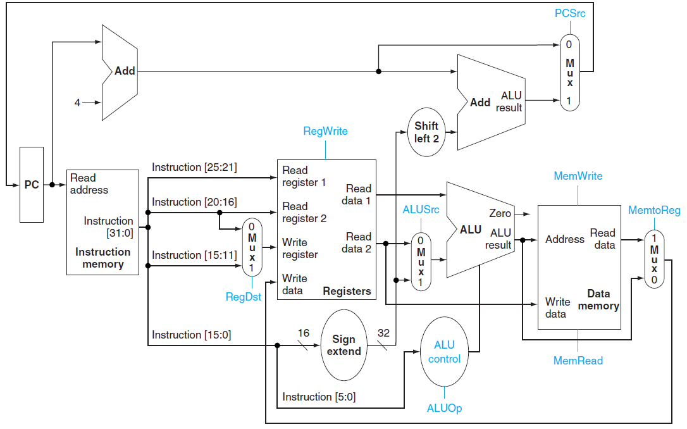

Single Cycle Processor with Necessary Control Signal

Slide 10
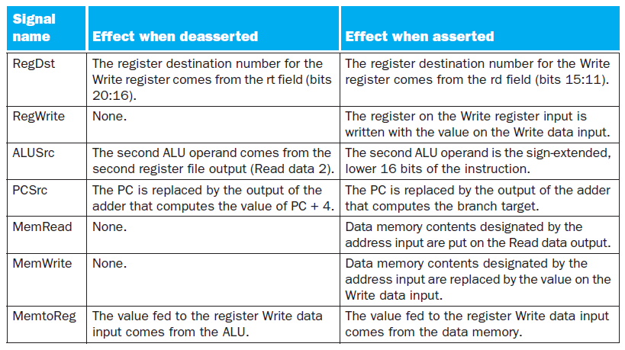
The Effect of the Control Signals

Slide 11
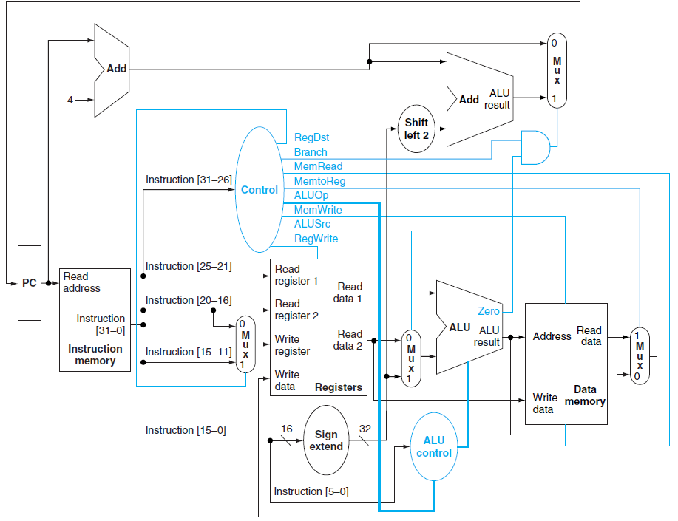
The Simple Datapath with Control Unit

Slide 12
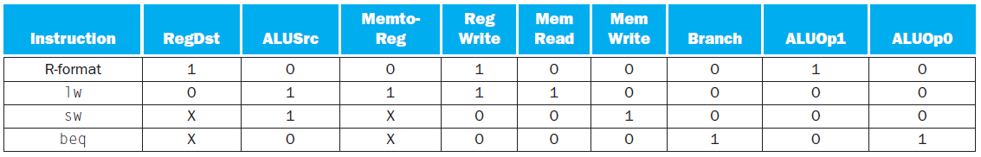
The Setting of Control Lines

Slide 13
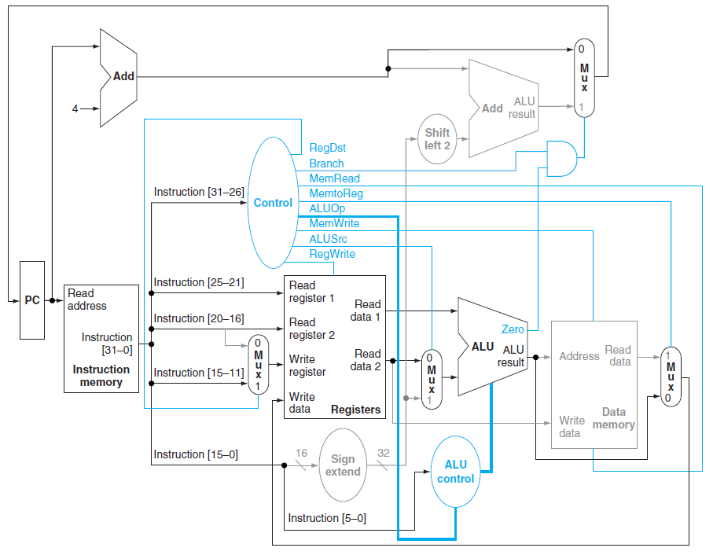
The Datapath in Operation for an R-type Instruction
RegDst=1 ALUSrc=0 MemtoReg=0 RegWrite=1
MemWrite=0 MemRead=0 Branch=0 ALUOp=10

Slide 14
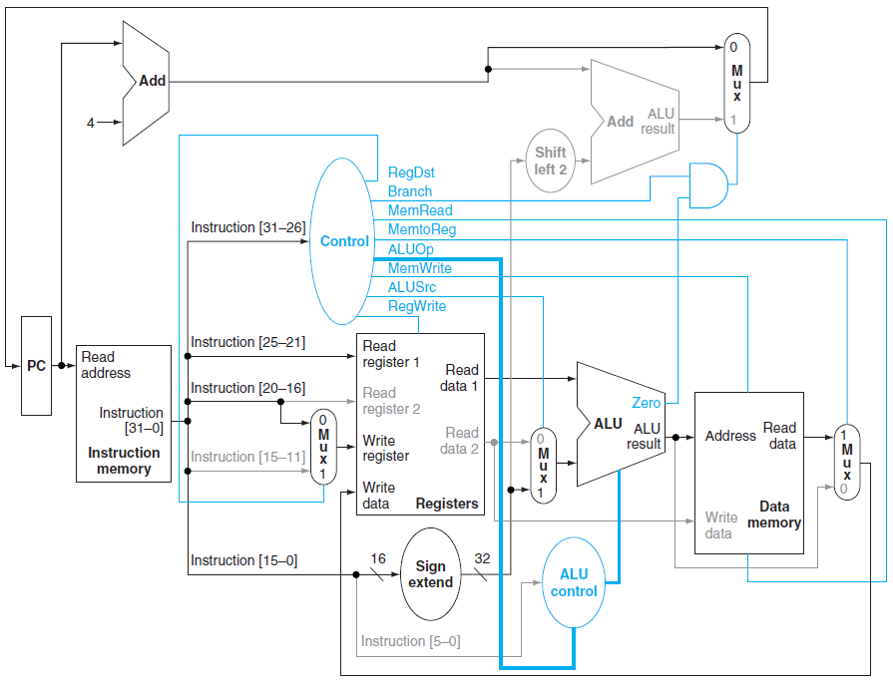
The Datapath in Operation for a Load Instruction
RegDst=0 ALUSrc=1 MemtoReg=1 RegWrite=1
MemWrite=0 MemRead=1 Branch=0 ALUOp=00

Slide 15
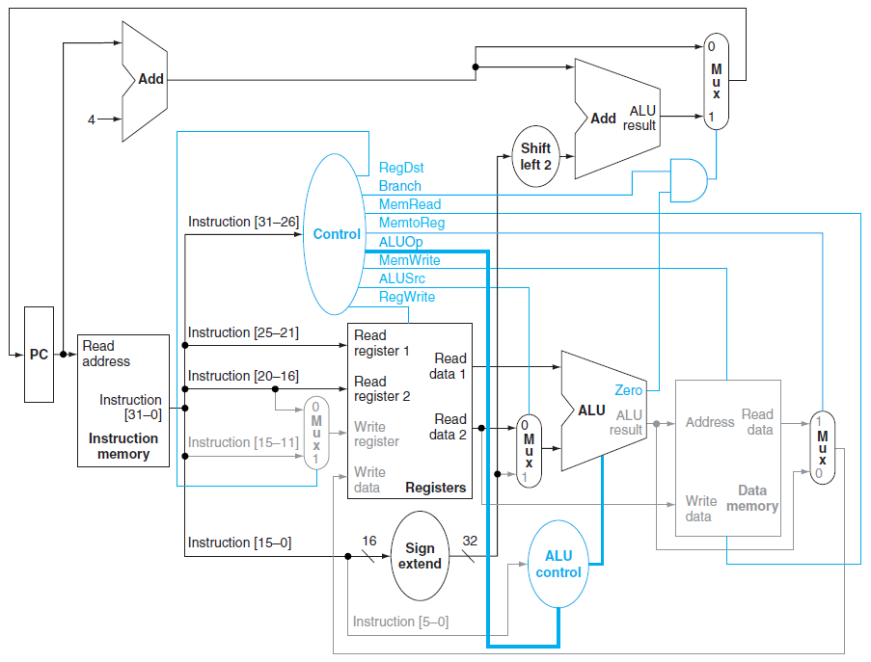
The Datapath in Operation for a Branch Equal Instruction
RegDst=X ALUSrc=0 MemtoReg=X RegWrite=0
MemWrite=0 MemRead=0 Branch=1 ALUOp=01

Slide 16
Implementing Jumps
Format of J-type Instruction:
A jump is calculated by storing into the PC the concatenation of:
1. The upper 4-bits of the current PC+4
2. The 26-bit immediate field of the Jump instruction
3. The bits 00₂
Implementation of Jump requires:
1. An additional multiplexor
2. Control signal Jump from the main control unit.
6 26
Opcode Address

Slide 17
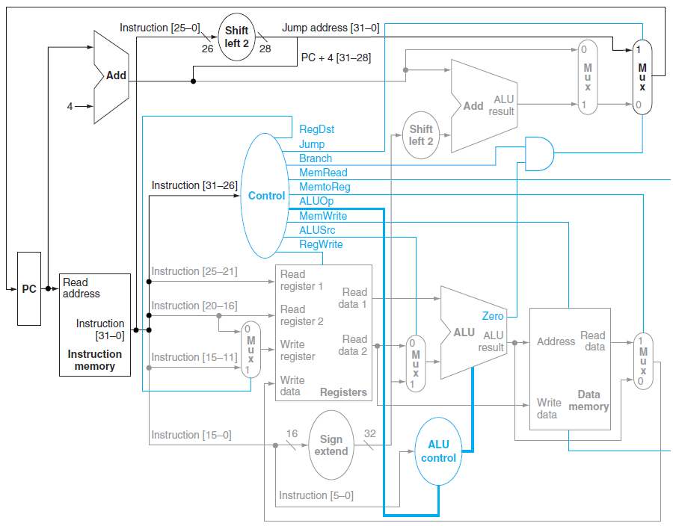
Control and Datapath to Handle the Jump Instruction

Slide 18
Why a Single Cycle Instruction Is Not Used Today?
The clock cycle must have same length for every instruction.
The cycle time must be long enough for the load instruction.
The performance is not good since, several of the instruction classes could fit in a shorter clock cycle.

